Slide 1
Non-Compensatory Psychological Models for Recommender Systems
Chen Lin, Xiaolin Shen, Si Chen
Xiamen University
Muhua Zhu
Alibaba Group
Yanghua Xiao
Fudan University

Slide 2
Literature Overview
Latent Factor Models
Nearest Neighbor
Compensatory Evaluation Rules
Brand | Battery life | Price | Memory | Decision
iPhone SE | 13 hours | 700 | 64 GB | best
Galaxy S8 | 9 hours | 500 | 128 GB
Honor 10 | 24 hours | 589 | 128 GB
User preference
0.7x0.5+0.3x0.7+0.8x0.5

Slide 3
Non-Compensatory Evaluation Rules
Lexicographic Rules
Conjunctive Rules
Cut-off
<700 >64GB
Prominent aspect
Brand | Battery life | Price | Memory | Decision
iPhone SE | 13 hours | 700 | 64 GB | Unacceptable
Galaxy S8 | 9 hours | 500 | 128 GB | Second best
Honor 10 | 24 hours | 589 | 128 GB | Best
User preference

Slide 4
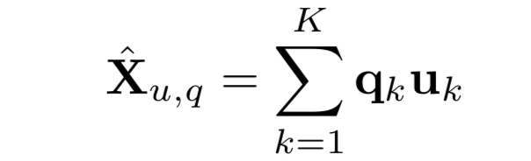
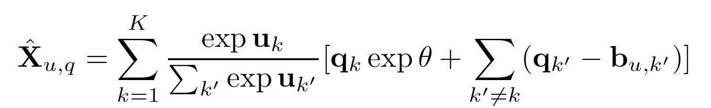
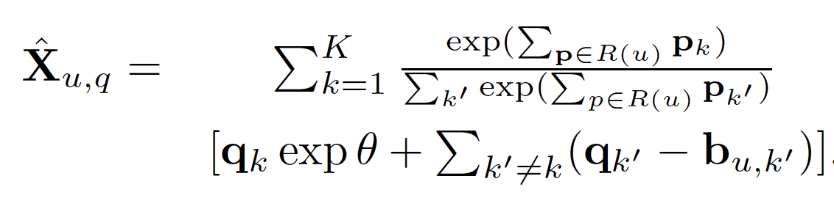
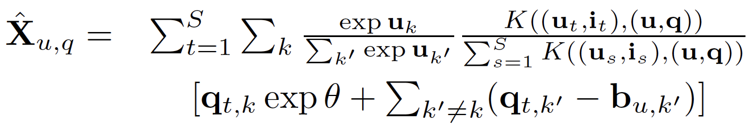
Non-Compensatory Rating Models
From MF
To MF-N
Variants
AMF-N
LLORMA-N
Strength of prominent aspect
Bias
for each user at each aspect

Slide 5
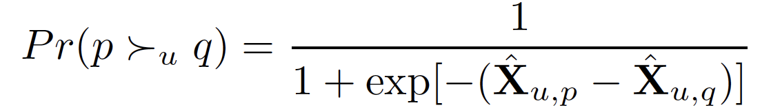
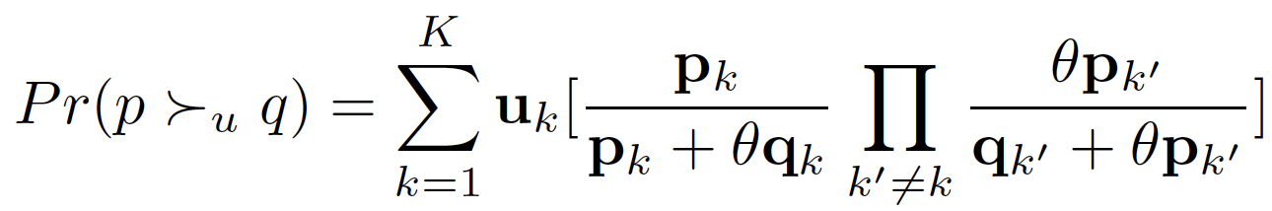
Non-Compensatory Ranking Models
Thurstone Model
Bradley-Terry Model
On prominent aspect, significantly better
On non-prominent aspects,
not too bad

Slide 6
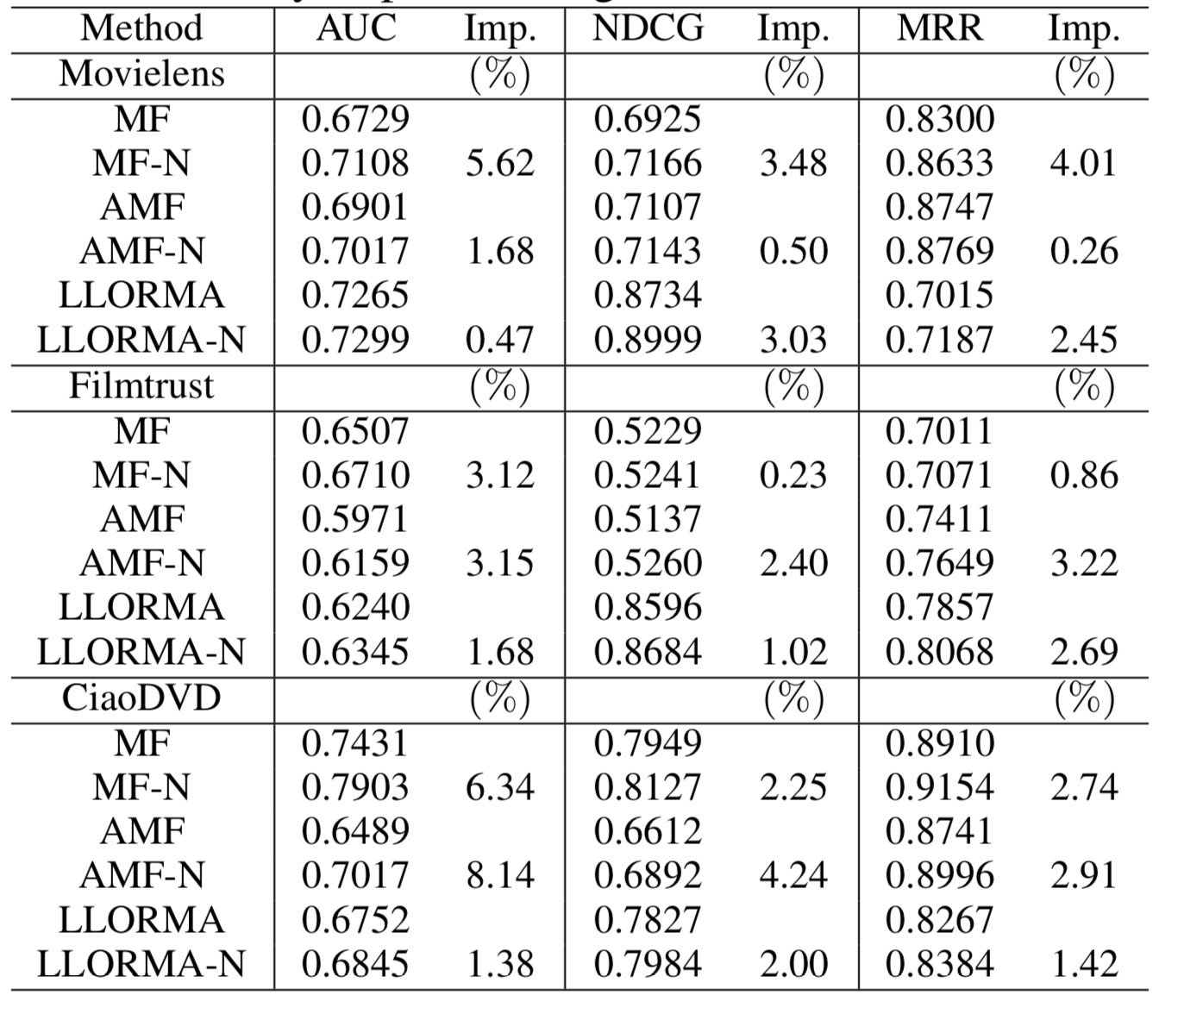
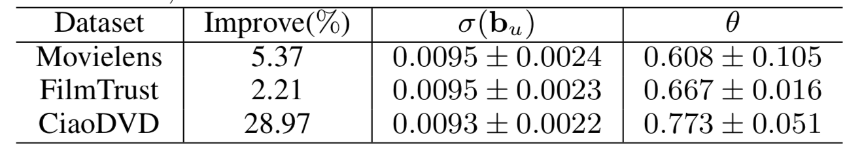
Results (rating prediction)
b not activated
b activated

Slide 7
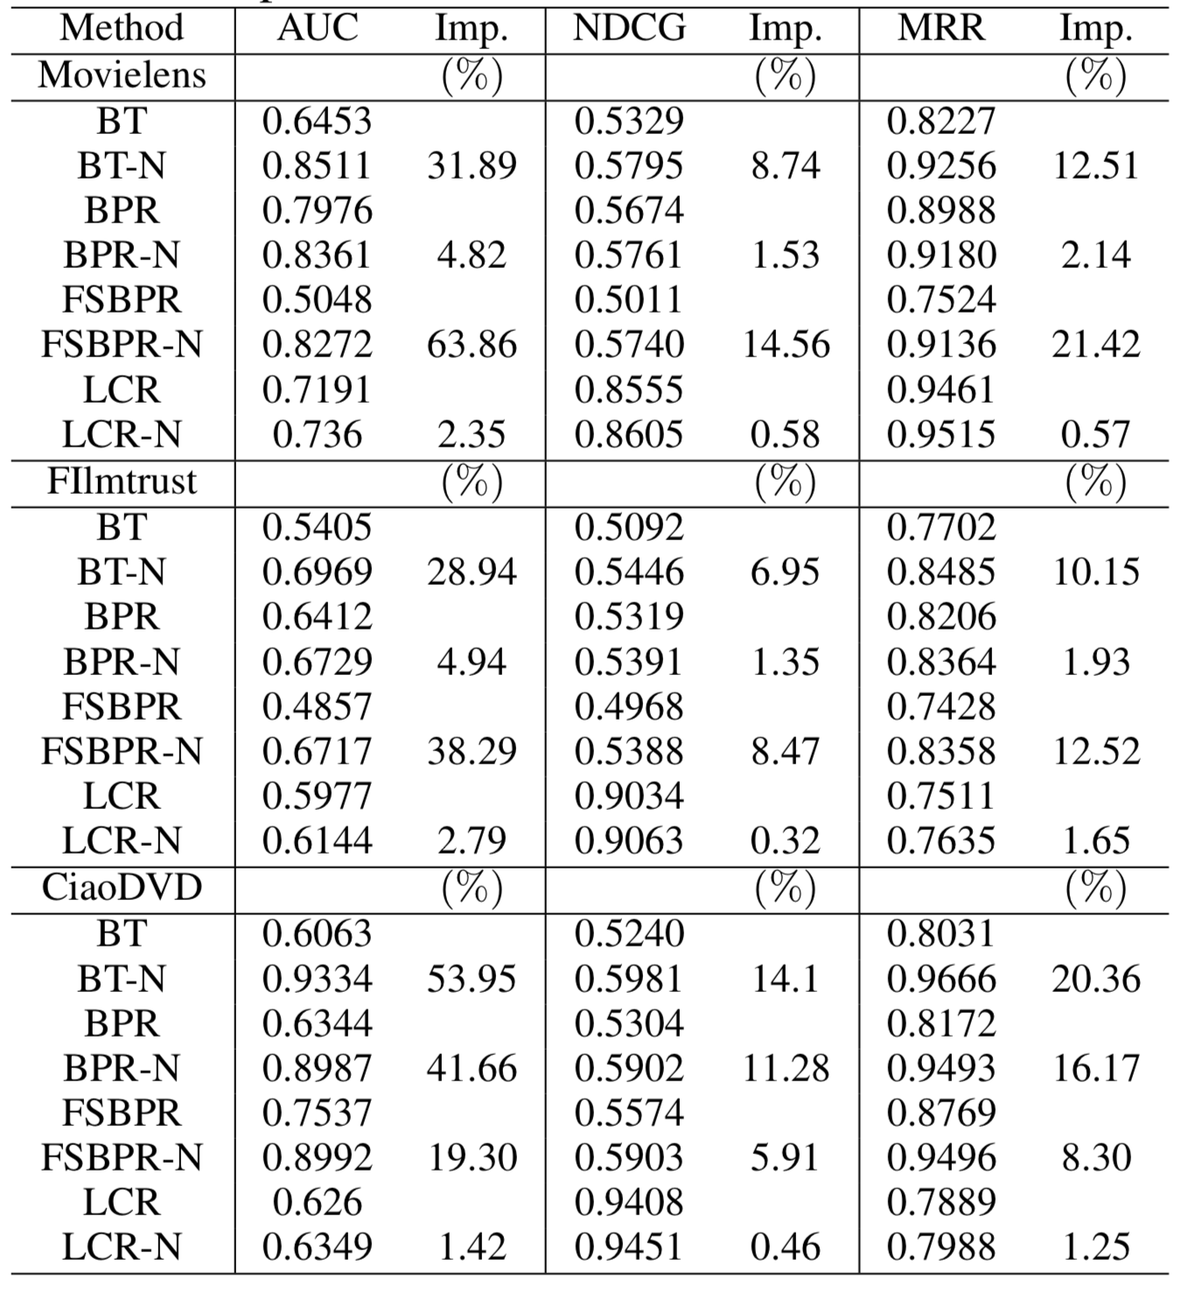
Results (ranking explicit feedback)

Slide 8
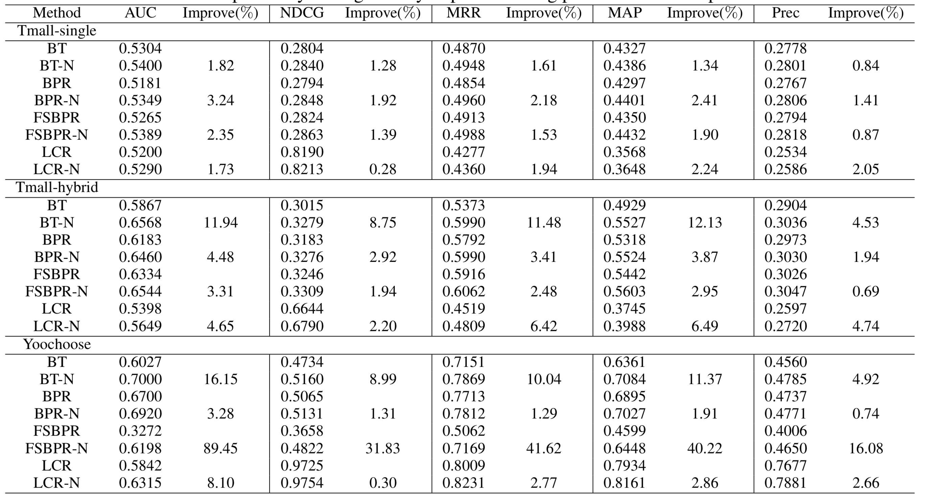
Results (ranking implicit feedback)

Slide 9
Conclusion
The proposed non-compensatory framework universally improves recommendation performances of different existing models
Rating models
Ranking models

